Slide 1

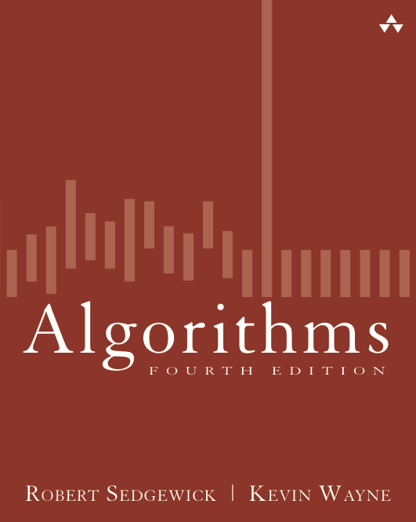
2.1 Knuth Shuffle Demo
Algorithms
Robert Sedgewick | Kevin Wayne
http://algs4.cs.princeton.edu

Slide 2









Knuth shuffle
In iteration i, pick integer r between 0 and i uniformly at random.
Swap a[i] and a[r].

Slide 3
Knuth shuffle
In iteration i, pick integer r between 0 and i uniformly at random.
Swap a[i] and a[r].
i
r
not yet seen

Slide 4

Knuth shuffle
In iteration i, pick integer r between 0 and i uniformly at random.
Swap a[i] and a[r].
i
r
not yet seen

Slide 5
Knuth shuffle
In iteration i, pick integer r between 0 and i uniformly at random.
Swap a[i] and a[r].
i
shuffled
not yet seen

Slide 6
Knuth shuffle
In iteration i, pick integer r between 0 and i uniformly at random.
Swap a[i] and a[r].
r
i
shuffled
not yet seen

Slide 7
Knuth shuffle
In iteration i, pick integer r between 0 and i uniformly at random.
Swap a[i] and a[r].
r
i
shuffled
not yet seen

Slide 8
Knuth shuffle
In iteration i, pick integer r between 0 and i uniformly at random.
Swap a[i] and a[r].
i
shuffled
not yet seen

Slide 9
Knuth shuffle
In iteration i, pick integer r between 0 and i uniformly at random.
Swap a[i] and a[r].
r
i
shuffled
not yet seen

Slide 10
Knuth shuffle
In iteration i, pick integer r between 0 and i uniformly at random.
Swap a[i] and a[r].
r
i
shuffled
not yet seen

Slide 11
Knuth shuffle
In iteration i, pick integer r between 0 and i uniformly at random.
Swap a[i] and a[r].
i
shuffled
not yet seen

Slide 12
Knuth shuffle
In iteration i, pick integer r between 0 and i uniformly at random.
Swap a[i] and a[r].
r
i
shuffled
not yet seen

Slide 13
Knuth shuffle
In iteration i, pick integer r between 0 and i uniformly at random.
Swap a[i] and a[r].
r
i
shuffled
not yet seen

Slide 14
Knuth shuffle
In iteration i, pick integer r between 0 and i uniformly at random.
Swap a[i] and a[r].
i
shuffled
not yet seen

Slide 15
Knuth shuffle
In iteration i, pick integer r between 0 and i uniformly at random.
Swap a[i] and a[r].
r
i
shuffled
not yet seen

Slide 16
Knuth shuffle
In iteration i, pick integer r between 0 and i uniformly at random.
Swap a[i] and a[r].
r
i
shuffled
not yet seen

Slide 17
Knuth shuffle
In iteration i, pick integer r between 0 and i uniformly at random.
Swap a[i] and a[r].
i
shuffled
not yet seen

Slide 18
Knuth shuffle
In iteration i, pick integer r between 0 and i uniformly at random.
Swap a[i] and a[r].
r
i
shuffled
not yet seen

Slide 19
Knuth shuffle
In iteration i, pick integer r between 0 and i uniformly at random.
Swap a[i] and a[r].
r
i
shuffled
not yet seen

Slide 20
Knuth shuffle
In iteration i, pick integer r between 0 and i uniformly at random.
Swap a[i] and a[r].
i
shuffled
not yet seen

Slide 21
Knuth shuffle
In iteration i, pick integer r between 0 and i uniformly at random.
Swap a[i] and a[r].
r
i
shuffled
not yet seen

Slide 22
Knuth shuffle
In iteration i, pick integer r between 0 and i uniformly at random.
Swap a[i] and a[r].
r
i
shuffled
not yet seen

Slide 23
Knuth shuffle
In iteration i, pick integer r between 0 and i uniformly at random.
Swap a[i] and a[r].
i
shuffled
not yet seen

Slide 24
Knuth shuffle
In iteration i, pick integer r between 0 and i uniformly at random.
Swap a[i] and a[r].
r
i
shuffled
not yet seen

Slide 25
Knuth shuffle
In iteration i, pick integer r between 0 and i uniformly at random.
Swap a[i] and a[r].
r
i
shuffled
not yet seen

Slide 26
Knuth shuffle
In iteration i, pick integer r between 0 and i uniformly at random.
Swap a[i] and a[r].
i
shuffled
not yet seen

Slide 27
Knuth shuffle
In iteration i, pick integer r between 0 and i uniformly at random.
Swap a[i] and a[r].
r
i
shuffled

Slide 28
Knuth shuffle
In iteration i, pick integer r between 0 and i uniformly at random.
Swap a[i] and a[r].
r
i
shuffled

Slide 29
Knuth shuffle
In iteration i, pick integer r between 0 and i uniformly at random.
Swap a[i] and a[r].
shuffled

